Slide 1
Hypothesis Testing

Slide 2
Outline of Today’s Discussion
Please refrain from typing, surfing or printing during our conversation! ☺
Logic of Hypothesis Testing
Evaluating Hypotheses

Slide 3
Part 1
The Logic of Hypothesis Testing

Slide 4
The Research Cycle
Real
World
Research
Representation
Abstraction
Generalization
Methodology
***
Research
Conclusions
Data Analysis
Research
Results
Frequency Distributions
Z-Scores / Percentiles
Evaluating Hypotheses

Slide 5
Logic of Hypothesis Testing
One might think about a hypothesis as a statement of the relationship between variables.
Whenever we evaluate hypotheses, there is a chance of error.
To minimize errors, and to help other researchers understand the conclusions we’ve drawn, there are standard procedures for hypothesis testing.
Hypothesis testing can be construed as a four-step process…

Slide 6
Logic of Hypothesis Testing
The first step involves stating the hypotheses.
By convention, the hypotheses are stated in terms of population parameters (μ and/or σ), rather than sample statistics (m, Xbar, and s).
This is because, in inferential statistics, we seek to make general statements about the population, even though we have only a sample to use.
By convention, we state a null hypothesis and an alternate hypothesis…

Slide 7
Logic of Hypothesis Testing
The Null Hypothesis is shown as H₀.
The Alternative Hypothesis is shown as H₁.

Slide 8
Logic of Hypothesis Testing
The second step in hypothesis testing involves setting the criteria for rejecting the null hypothesis. This is sometimes called “setting the alpha level”.
The third step involves obtaining sample data. It is best to obtain sample data AFTER the hypotheses and decision criterion have been set.
The fourth step involves deciding between two alternatives: Reject the null hypothesis; Fail to reject the null hypothesis.
Why don’t we state, instead, that we have proven the alternative hypothesis?

Slide 9
Logic of Hypothesis Testing
These subtleties in logic are important in science, and in the U.S. legal system.
Note that jurors are NOT asked to decide if a defendant is innocent.
Instead jurors essentially reject, or retain the “null hypothesis”.
In our legal system, the null hypothesis is that the defendant is Not Guilty. Jurors are suppose to stick with the null hypothesis until there is a substantial evidence to reject it. (Scientists are suppose to do the same.)

Slide 10
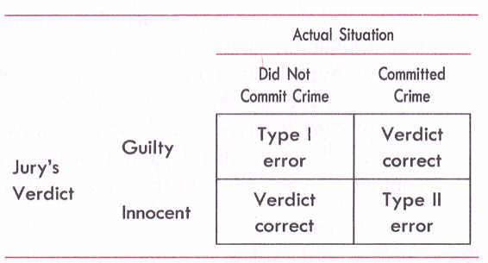
Logic of Hypothesis Testing
Not Guilty
These are the errors a jury could make.

Slide 11
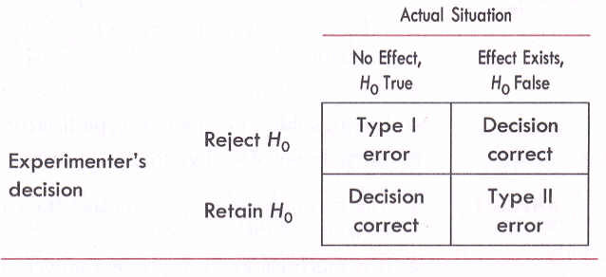
Logic of Hypothesis Testing
These are the errors a scientist could make.

Slide 12
Logic of Hypothesis Testing
Type I Error - an error in statistical inference that occurs when a null hypothesis is true, but is rejected. “Seeing too much in the data.”
Alpha (α) - The probability of making a Type I error.
Type II Error - an error in statistical inference that occurs when a null hypothesis is false, but is retained. “Not seeing enough in the data.”
Beta (β) - The probability of making a Type II error.

Slide 13
Logic of Hypothesis Testing
Potential Pop Quiz Question – Explain what is meant by the phrase “sensitivity of an experiment”.
Potential Pop Quiz Question – Identify the three factors that determine the power of a statistical test.

Slide 14
Part 2
Evaluating Hypotheses

Slide 15
Evaluating Hypotheses
In the previous section, we noted that scientists typically have to decide between two types of possible errors (Type I versus Type II).
So, the bad news we could be making an error.
The good news is that we can at least specify the probability of making either error type!
Yes, we might be wrong…but we know the probability of being wrong, and thus can quantify risk.

Slide 16
Evaluating Hypotheses
We can quantify the risk by taking advantage of the statistical properties of Gaussian distributions (i.e., normal, or Bell-shaped curve).
In particular, we can determine whether a particular score falls in the so-called critical region - the area in a distribution that contains extreme scores that are very unlikely to be observed if the null hypothesis is true…

Slide 17
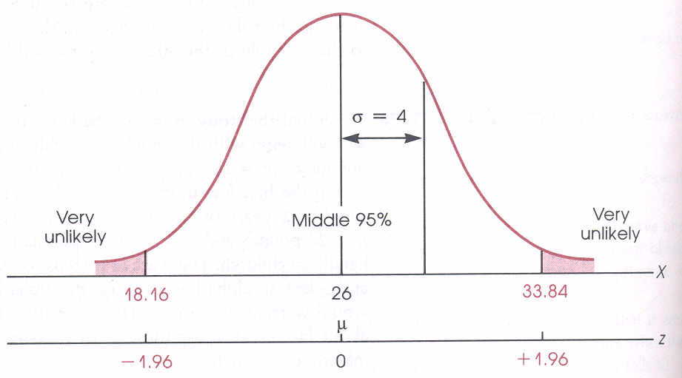
Evaluating Hypotheses
The critical region is shown in pink.

Slide 18
Evaluating Hypotheses
The critical region is also called the rejection region (or region of rejection).
That is, if a sample mean falls in the critical region, the null hypothesis is rejected…

Slide 19
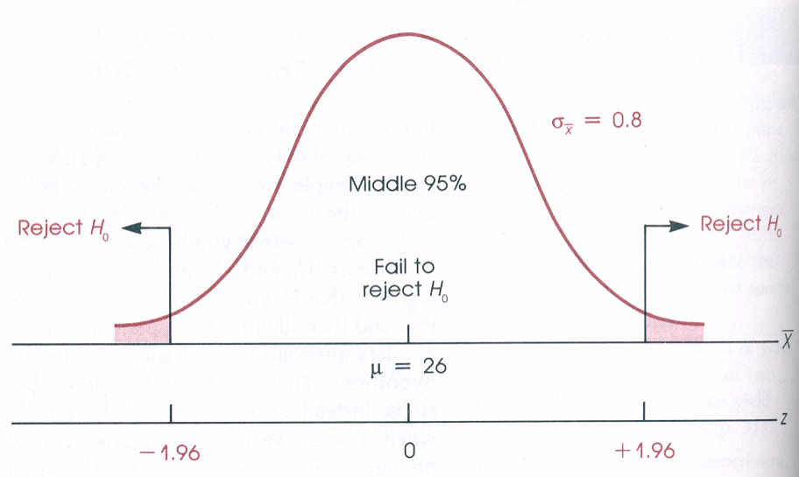
Evaluating Hypotheses
Sample means falling in the critical region
are rejected, and called “significantly different”.

Slide 20
Evaluating Hypotheses
So, yes, we might make a type I error, but typically the probability of such an error is 5%.
That is, we set our “alpha level” to 0.05, meaning that we have only a 5% chance of rejecting a null hypothesis that should have been retained.
In some cases, we might choose to minimize the risk of a type I error. We could choose a more stringent alpha level…

Slide 21
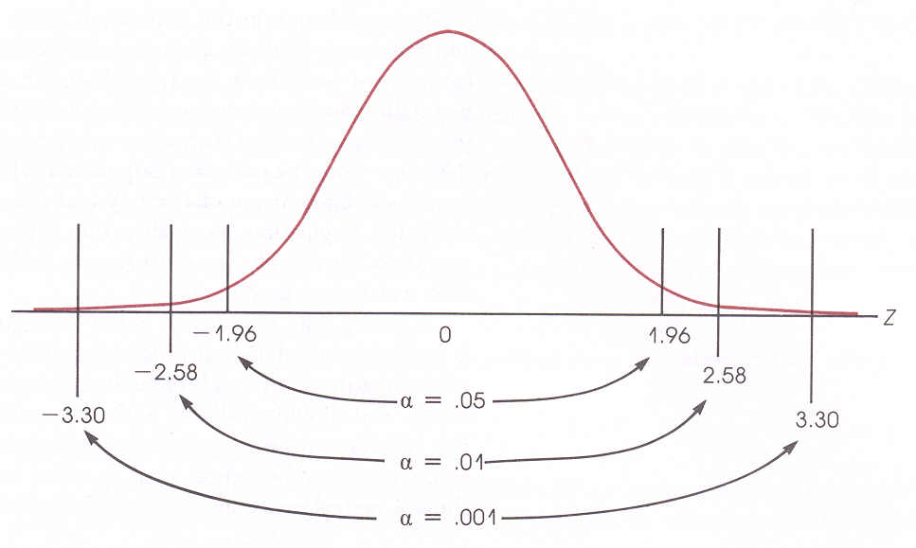
Evaluating Hypotheses
Alpha levels of 0.05, 0.01, and 0.001.

Slide 22
Evaluating Hypotheses

Slide 23
Acknowledgments
Images used in this educational presentation were obtained from Wikimedia Commons, in accordance with regulations regarding copyright, use, and dissemination.
http://commons.wikimedia.org/wiki/Main_Page

